Slide 1



Lecture 11: Cryptography
COMP260: Distributed Systems
BSc (Hons) Computing for Games

Slide 2
Today’s session:
Linux server workshop review
Why use encryption
Simple Encryption
Hard Encryption
Assignment 2 Review
Workshop

Slide 3
Linux server workshop review
Are you all comfortable with remote command line linux development and operation (devops)?

Slide 4
Linux server workshop review
Are you all comfortable with remote command line linux development and operation (devops)?
Git client is installed on server
Git pull instead of ftp client (filezilla)
Can run httpserver from your accounts with a different port to your socket server
See httpserver from COMP130 last year
Can host web content if you want
Symlink from your home/<user> folders

Slide 5
Why use encryption

Slide 6
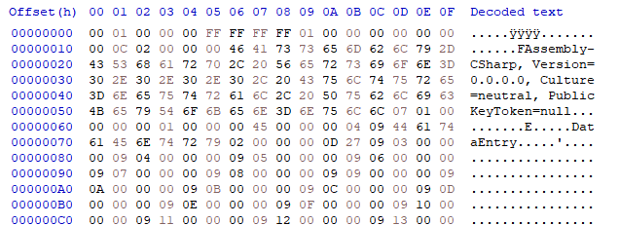
Why use encryption
As we saw in week 5
Unencrypted data enables passive hacking attacks
3rd parties can read your data as a byte steam
Even using packet formats, it is still effectively a byte stream

Slide 7
Why use encryption
As a service provider, we don’t want people to read our secrets
Regardless of how trivial they are
Black boxes provide a lot of security
Any security is better than none
Often hackers will look for better low-hanging fruit

Slide 8
Simple Encryption

Slide 9
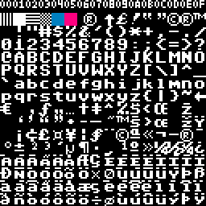
Simple Encryption
At its simplest level, we want to have an approach to encryption that will move data away from being in a plain-text format
utf-8
8-bit Unicode format
1-4 bytes of data per character to encode all known alphabets
1-byte for English text (no accents)
2-4 bytes for everything else
Extends original ASCII format (1 byte) left

Slide 10
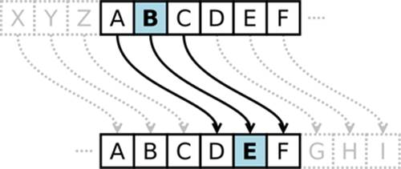
Simple Encryption
Traditional replacement and swizzling approaches
Caesar’s cypher (static offset)
https://inventwithpython.com/chapter14.html
Often quoted as a simple approach that is cryptographically valueless
Will turn text into garbage to stop casual inspection

Slide 11
Simple Encryption
Traditional replacement and swizzling approaches
Caesar’s cypher (static offset)
Very easy to brute-force text with a dictionary
Can solve with visual inspection, given ordering of letter and letter frequency
Can be made more interesting with dynamic offsets

Slide 12
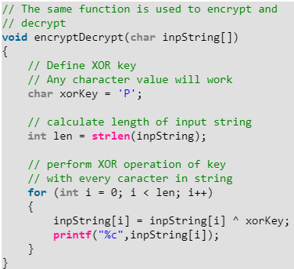
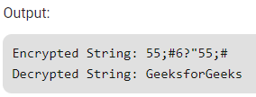
Simple Encryption
Traditional replacement and swizzling approaches
XOR approaches
https://www.geeksforgeeks.org/xor-cipher/
Bit-swizzling / twiddling with the XOR or ^ operator

Slide 13
Simple Encryption
Traditional replacement and swizzling approaches
XOR approaches
Again, extremely easy to brute-force due to static look up from A->B

Slide 14
Simple Encryption
Traditional replacement and swizzling approaches
Data compression
https://docs.python.org/3/library/zlib.html
A side effect of compressing data is that it makes it hard to read
Helps if data payload is quite large for this, often compressors will dump plain data if compression is larger than raw data
Due to lookup table overheads

Slide 15
Simple Encryption
Traditional replacement and swizzling approaches
Data compression
Often compressed data will have clear footprints (headers / sections) making it obvious that the data is compressed
Can XOR to get round this ;)
Or strip some header parts
Or move data around in payload :)

Slide 16
Simple Encryption
Traditional replacement and swizzling approaches
Although simple approaches are very bad on their own, they can create value when combined
Often, data that cannot be easily decrypted is left alone for data that can
Unless the data has potential value

Slide 17
Hard Encryption

Slide 18
Hard Encryption
Python has lots of cryptography libraries and functionality
From its widespread us as a backend service
And the wide availability of lots of cryptography technologies

Slide 19
Hard Encryption
Import cryptography.Fernet
Fernet is a key-based symmetric encryption method
Part of cryptography package

Slide 20
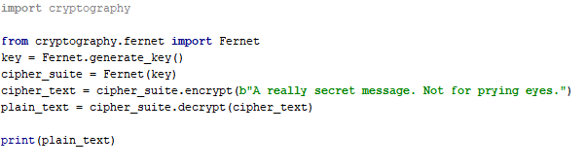
Hard Encryption
01.fernet
Uses a shared key between encrypt and decrypt
Can use password salt as the key
As it’s sent to the client anyway
Unique per client so fair secure
Fernet.generatekey() creates a longer key than the md5 examples the other week

Slide 21
Hard Encryption
02.cryptodome
Cryptodome is a rework of an unsupported crypto package
Import into project
AES cipher is more complex than Fernet
‘Advanced Encryption Standard’
Our Rijndael-based approach for assignment
But still relies on shared keys

Slide 22
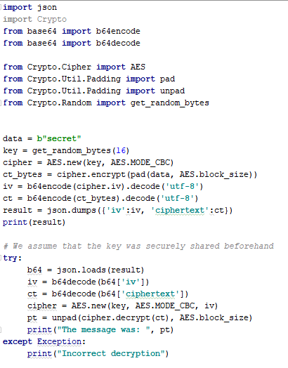
Hard Encryption
02.cryptodome
Sending side
Key is a shared 16 byte random byte array (from [password salt)
Is used to generate ciphers
Send the cipher encrypted data and initialisation vector (IV) to the recipient as json

Slide 23
Hard Encryption
02.cryptodome
Receive side
Key is a shared 16 byte random byte array (salt)
Generate a new cipher using the shared key and IV
Decrypt the data to reveal its true meaning

Slide 24
Hard Encryption
02.cryptodome
Receive side
Key is a shared 16 byte random byte array (salt)
Key is not sent with data (obviously)
Apart from initial log on
To locally hash user password before sending to server for validation

Slide 25
Hard Encryption
02.cryptodome
Have more data to play with
Can use simple encryption techniques on top of this
And store data in interleaved formats to make it harder to unpack

Slide 26
Hard Encryption
Packet management
Given we’ve looked at formats like:
<ID><LENGTH><DATA>
Makes it fairly easy to see where the data is
An approach of
<DATA.FIXED>
Makes this far harder to unpack
(and to write / test)

Slide 27
Hard Encryption
Packet management
<DATA.FIXED>
To decrypt as cryptodome we need:
IV
Data
Datasize.2
Also need to know it’s ‘our’ data
ID.4

Slide 28
Hard Encryption
Packet management
Decompress <DATA.FIXED> into
<ID.4><cryptsize.2><IV><encrypted data>
cryptsize = size of IV + data
Don’t need to store data in such an obvious format
Anything that makes it hard to unpack will scare hackers away
<ID.1><cryptsize.2><ID.1><IV><ID.1>< encrypted data ><ID.1>
Or split IV and encrypted data so they aren’t contiguous

Slide 29
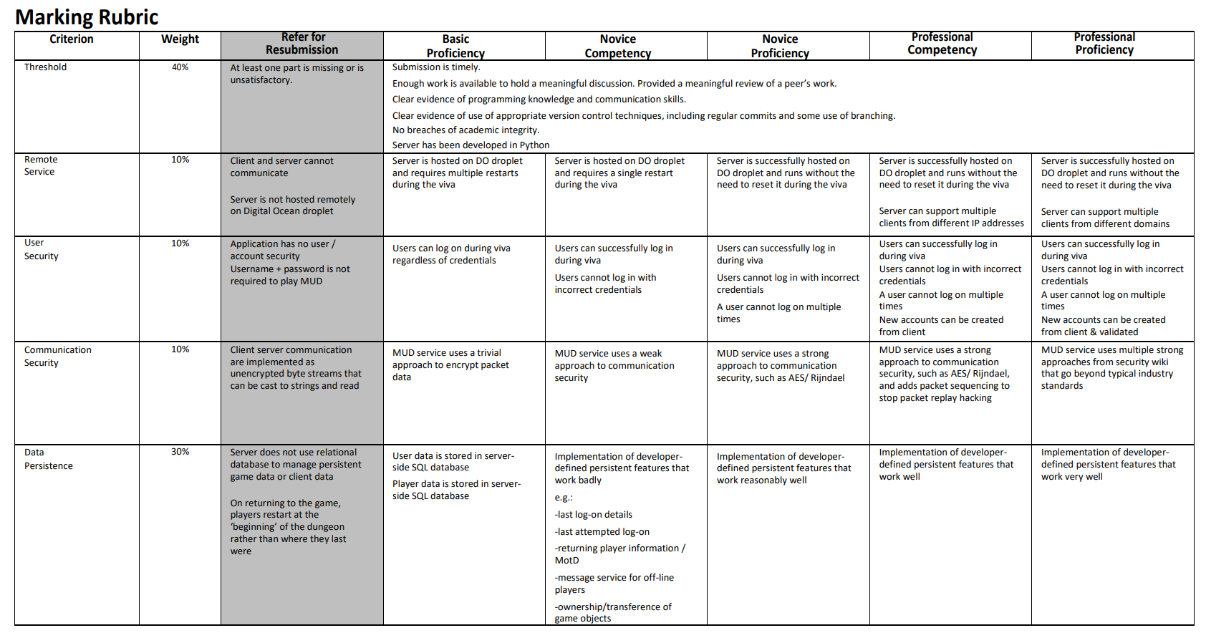
Assignment 2 Review

Slide 30
Workshop
This week:
Assignment support :)

Slide 31
Questions

